Slide 1

AFFLUENCE PREDICTION by Yang Kewen
29th March 2024

Slide 2



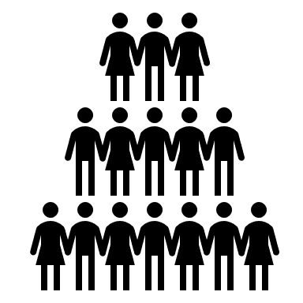



Problem Statement
Targeted Marketing
AI model predicts
Affluent
More Sales
Bank Customer
Normal

Slide 3

Exploratory Data Analysis
66083 rows, 30 columns
25 columns with missing value
- 17 columns with more than 50% missing values
- 6 columns with more than 90% missing values
Target Variable C_ID, not unique
Target Variable "C_seg" is imbalance
- Normal: 55K
- Affluent: 10K
Assessment.xlsx
6 nominal columns
1 ordinal columns

Slide 4
Exploratory Data Analysis
Required works
66083 rows, 30 columns
25 columns with missing value
- 17 columns with more than 50% missing values
- 6 columns with more than 90% missing values
Impute Missing values
Target Variable C_ID, not unique
Target Variable "C_seg" is imbalance
- Normal: 55K
- Affluent: 10K
Assessment.xlsx
6 nominal columns
1 ordinal columns

Slide 5
Exploratory Data Analysis
Required works
66083 rows, 30 columns
25 columns with missing value
- 17 columns with more than 50% missing values
- 6 columns with more than 90% missing values
Impute Missing values
Up-sampling or assign weights to examples
Target Variable C_ID, not unique
Target Variable "C_seg" is imbalance
- Normal: 55K
- Affluent: 10K
Assessment.xlsx
6 nominal columns
1 ordinal columns

Slide 6
Exploratory Data Analysis
Required works
66083 rows, 30 columns
25 columns with missing value
- 17 columns with more than 50% missing values
- 6 columns with more than 90% missing values
Impute Missing values
Up-sampling or assign weights to examples
One hot encoding
Target Variable C_ID, not unique
Target Variable "C_seg" is imbalance
- Normal: 55K
- Affluent: 10K
Assessment.xlsx
6 nominal columns
1 ordinal columns

Slide 7
Data Processing
Data Cleaning
- “HL_tag” and “AL_tag” can be imputed with 0 with Assumption that NaN represents 0 in raw dataset
- “PC” can be dropped because it’s a dummy postal code
Standardize numeric features
Assessment.xlsx

Slide 8
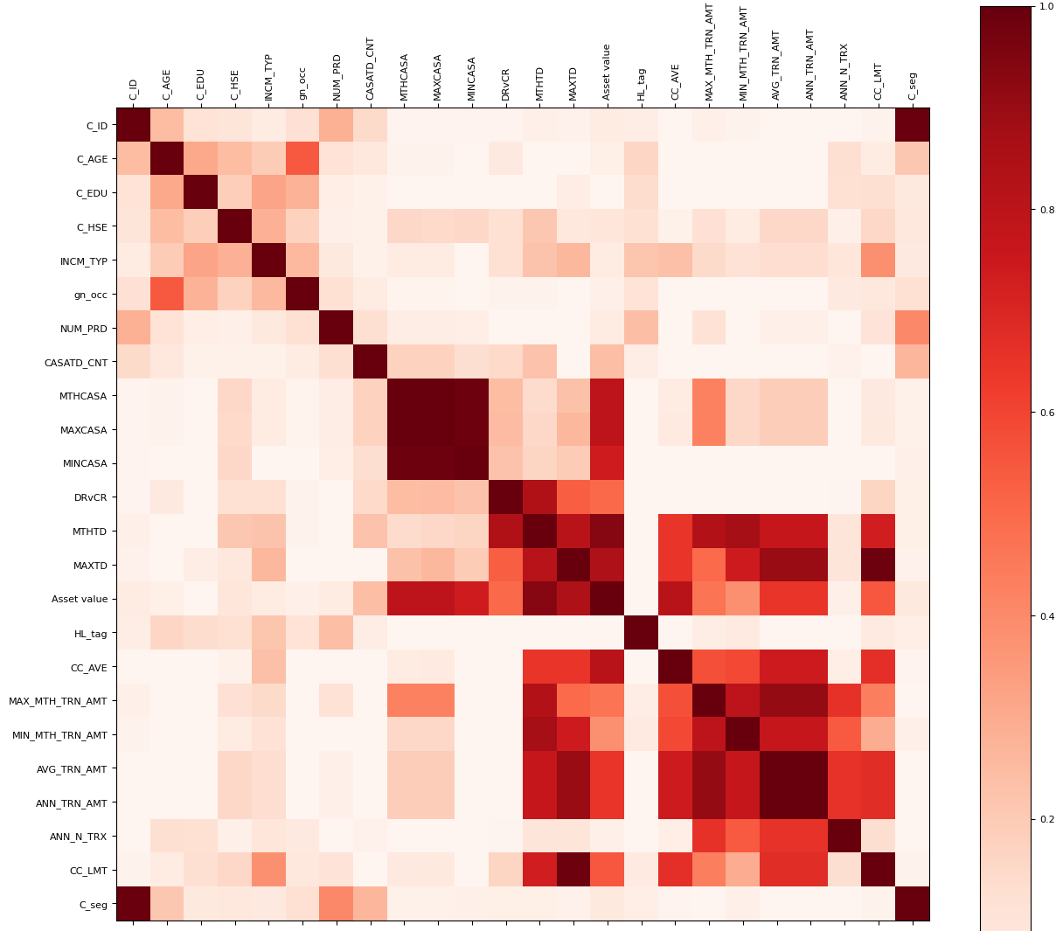
Correlation Analysis
Based on correlation matrix, the features that are more correlated with target variable are:
- C_AGE (Age)
- gn_occ (Occupation)
- NUM_PRD (Number of Products)
- CASATD_CNT (Number of Accounts)

Slide 9

Feature Engineering
counts features
Operations:
Add
Subtract
Multiply
Divide
values features
Numeric Features
Deep Synthetic Features
Auto-Feature
Engineering Tool
Processed Data
Final Dataset
One Hot Encoder
Categorical Features
Encoded Features
By feature engineering, we expanded the features from 29 features to 613 features
Notes:
One hot encoding for categorical features ['INCM_TYP', 'C_EDU', 'C_HSE', 'gn_occ', 'HL_tag', ‘AL_tag']

Slide 10
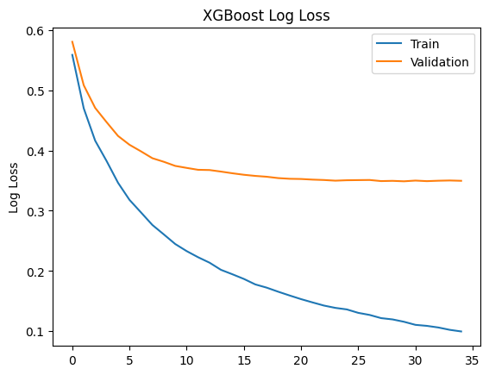
Model Training – XGBoost
Stratified train test split by 9:1
Choose XGBoost model because
SOTA for tabular dataset prediction
Can handle missing value better
Support GPU training and inference
RandomizedSearch for best set of hyperparameters
params = {
"colsample_bytree": [0.5, 0.6, 0.7, 0.8, 0.9],
"gamma": uniform(0.3, 0.7),
"max_depth": [8, 9, 10, 11, 12],
"n_estimators": randint(30, 80),
"subsample": [0.6, 0.7, 0.8, 0.9],
"min_child_weight": [1, 1.5, 2, 2.5],
"eta": [0.3, 0.1, 0.05]}
Based on train-validation curve, the model can be trained on around 34 epochs.
After fitting all parameters to XGBoost model, we performed Threshold Moving and the final f1 = 0.924 on test dataset

Slide 11
Model Training – MLP
 | XGBoost | MLP
Missing Value | sparsity-aware algorithm | KNN impute
Imbalance Target Variable | Sample Weighted training | Smote Up-Sampling
Architecture | Tree-based ensemble | Neural Network
Training Time (CPU) | 7.72s | 58s
Inference Time (CPU) | 29ms | 26ms
F1 score on test | 0.924 | 0.885
After fitting all parameters to XGBoost model, we performed Threshold Moving and the final f1 = 0.924 on test dataset

Slide 12
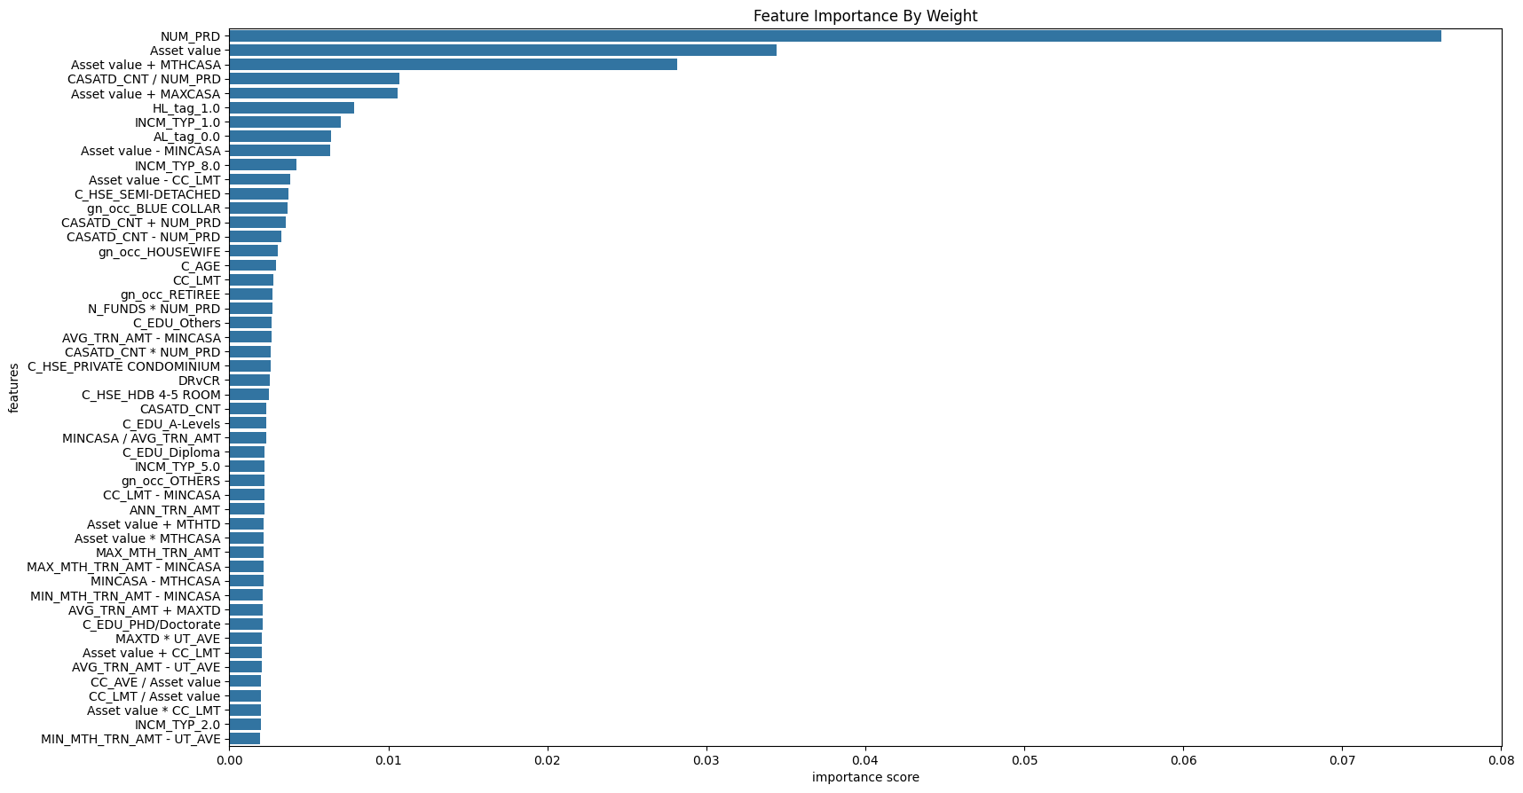
Model Interpretation
Based on feature importance graph, we can perform feature selection to reduce model size and inference speed.

Slide 13
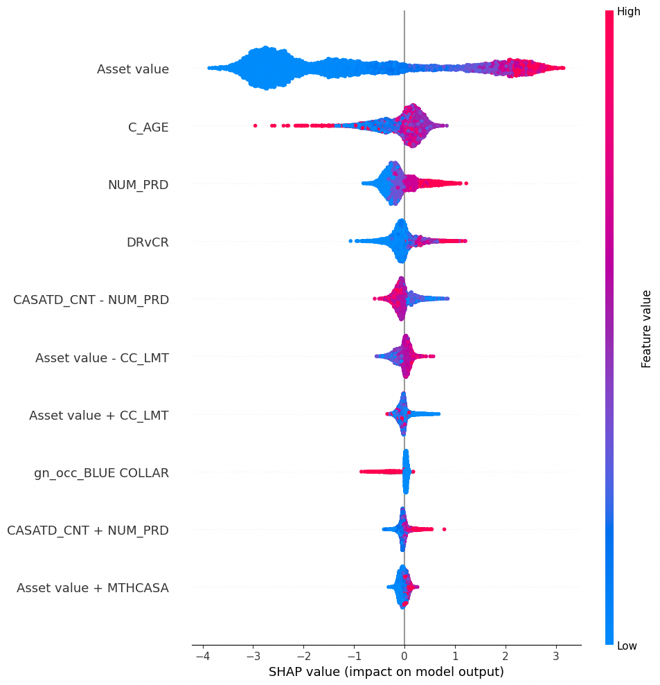
Model Interpretation
Based on SHAP plot, we can examine the impact of each important feature to the target variable.
- e.g., Larger Asset value implies more potential to be Affluent.

Slide 14
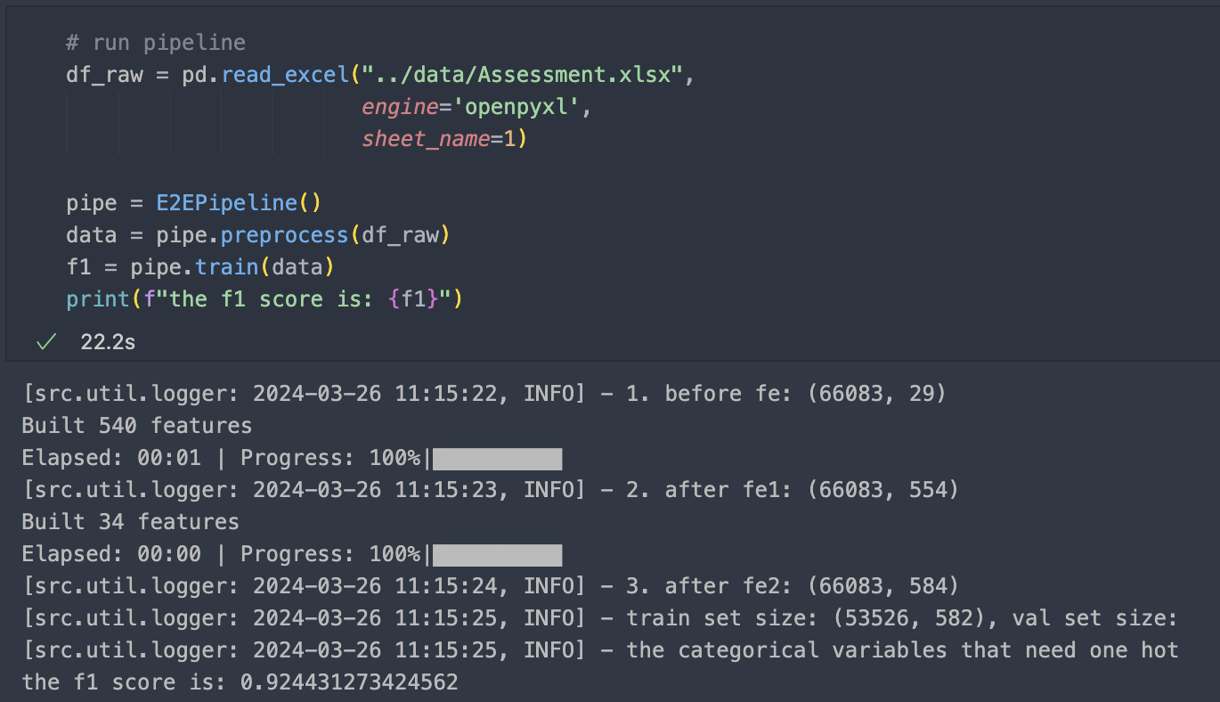
Package For Deployment
GitHub Repo: https://github.com/yang0369/Maybank_Classification/
📦Maybank_Classification
┣ 📂analysis
┃ ┣ 📜experiment_nn.ipynb
┃ ┗ 📜experiment_xgboost.ipynb
┣ 📂data
┃ ┗ 📜Assessment.xlsx
┣ 📂model
┃ ┣ 📜encoder
┃ ┗ 📜xgboost.json
┣ 📂src
┃ ┣ 📂config
┃ ┃ ┗ 📜config.py
┃ ┣ 📂util
┃ ┃ ┗ 📜logger.py
┃ ┣ 📜E2EPipeline.py
┃ ┗ 📜test.py
┣ 📂tests
┃ ┗ 📜test_performance.py
┣ 📜README.md
┗ 📜requirements.txt
Run Training Pipeline with E2EPipeline:

Slide 15
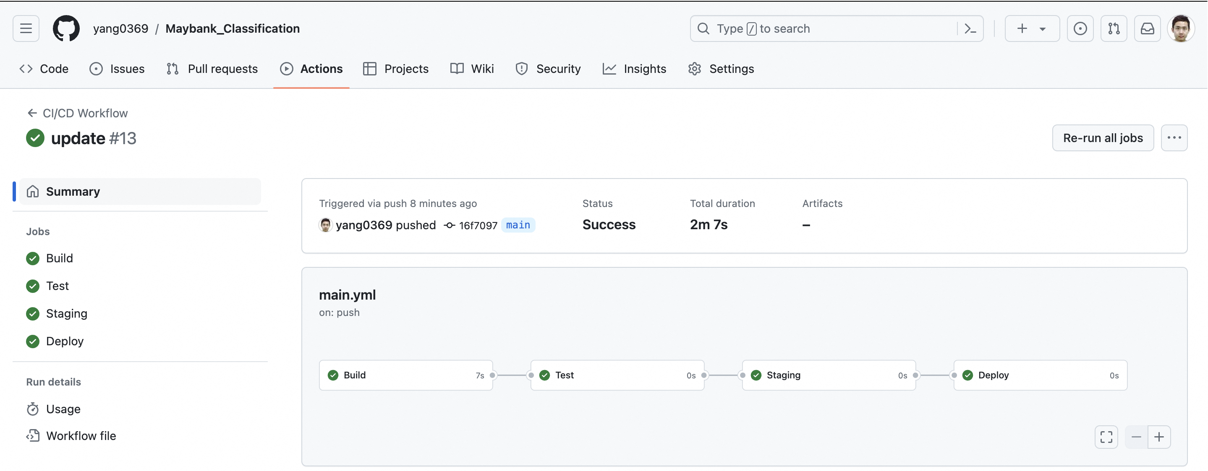
CICD Pipeline

Slide 16



Continuous Deployment
Model Analysis
ML
EDA
Data Processing
Model Training
Evaluation And Validation
CICD
Deployment
Automated Continuous Training Pipeline
CT
Data Validation
Data Processing
Model Training
Evaluation And Validation
Trained Model
Trigger running CT
Ops
Monitoring
Service
Prediction
Service
Model Serving
Data Storage
Model Registry
Notes:
Ref: https://cloud.google.com/architecture/mlops-continuous-delivery-and-automation-pipelines-in-machine-learning
Benefits:
traceability
streamline the process and automate routine works.
Continuous monitoring
improve:
Repeatability
Scalability
Maintainability
Reusability
Reliability

Slide 17
Summary
To predict affluent customer for bank, I have trained XGBoost model and MLP model, and evaluated their performance with f1 score on the same test dataset. Based on the evaluation metrics, XGBoost outperformed MLP with f1 = 0.922.
By SHAP interpretation graph, we can tell the correlations between important features and target variable, e.g. customers with more asset value and number of products tend to be more affluent.
After the experiments, I have built a training pipeline for XGBoost. This pipeline can be further dockerized for deployment. e.g. Dockerize the pipeline repo and deploy the docker image to AWS EC2, using AWS cloudwatch to monitor data drift etc.
By training and deploying this AI product, the bank can send targeted marketing to the predicted affluent customers, this could potentially be more efficient way for sale uplifting.
In addition, this AI model’s prediction could also be used as a data-driven way for customer segmentation, which could be useful to product customization.

Slide 18


